Slide 1
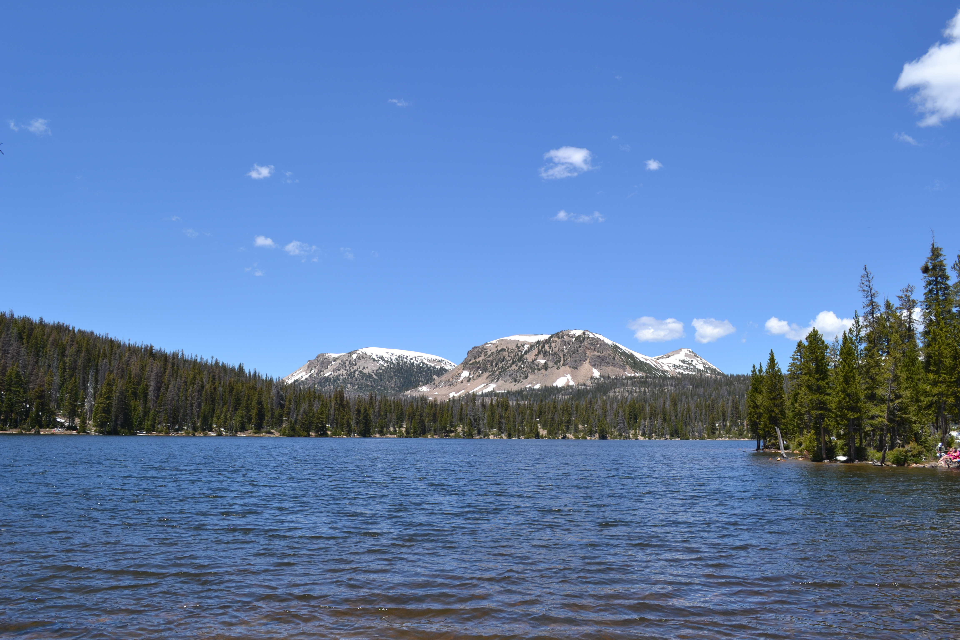
Initiating a New Division or Subdivision Area: Notices, Statutory Deadlines, and Consequences
Ben J. Jensen
Assistant Attorney General

Slide 2

General Adjudication Initiation
Two methods
  Petition from water users and SE investigation¹
  Converted case²
    ¹ Utah Code § 73-4-1(1)(a)&(b)
² Utah Code §§ 73-4-1(1)(c), -18

Slide 3
General Adjudication Final Decrees*
* Pre-McCarran Amendment? Groundwater?

Slide 4

Divisions and Subdivisions
2013 statutory amendments
  “[T]he state engineer may divide the general adjudication area into divisions and subdivisions if the state engineer [] fulfills the requirements of this chapter individually for each division or subdivision . . .”
  Utah Code § 73-4-1(3)

Slide 5


Steps
Newspaper commencement notice
Search list
Summons
Public meeting
Notice to submit claims
List of unclaimed rights
Blake Bingham will cover others…

Slide 6



Commencement Notice, Boundary, and Search List
Commencement Notice in the newspaper¹
  First designation of the division or subdivision
  Boundary description
SE creates “search list” by examining records²
Claimant obligations/statutory deadlines
  None yet
¹ Utah Code § 73-4-3(2)
² Utah Code § 73-4-3(3)

Slide 7



Summons and Public Meeting
Individual summons by mail¹
  Served on:
    All owners of record – the search list
    SE can identify potential claimants, where SE records are incomplete
Summons by publication²
  SE affidavit required
Initial public meeting³
Claimant obligations⁴
  Address and ownership changes
  Follow court proceedings
Statutory Deadlines
  None
¹ Utah Code §§ 73-4-3(4), -4(1)(a)
² Utah Code § 73-4-4(1)(b)
³ Utah Code § 73-4-3(7)
⁴ Utah Code § 73-4-21(1)

Slide 8


Notice to Submit Statement of Claim
Notice comes after the initial public meeting¹
Claimant obligation and statutory deadline²
  Submit any statements of claim within 90 days
Extensions
Prospective – SE can grant one 30 day ext.³
Retroactive – Court may grant if they demonstrate due cause⁴
¹ Utah Code § 73-4-3(8)(a)
² Utah Code § 73-4-5
³ Utah Code § 73-4-10(2)
⁴ Utah Code § 73-4-10(1)

Slide 9


Consequences of not filing a claim
Rights of record¹
  Evidence of an intent to abandon the right
Rights not of record²
  Barred at claim filing deadline
¹ Utah Code § 73-4-9(1)
² Utah Code § 73-4-9(2)

Slide 10

List of Unclaimed Rights (LUR)
Which water rights go on the LUR?
  Each water right of record where no claim was filed¹
Who gets notice?
  Served on each potential claimant that was served with a summons²
Claimant obligation
  Required to file an objection within 90 days along with a statement of claim³
Consequence⁴
  If no objection = abandonment
Public meeting⁵
¹ Utah Code § 73-4-9.5(1)(a)
² Utah Code § 73-4-9.5(1)(b)
³ Utah Code § 73-4-9.5(2)
⁴ Utah Code § 73-4-9.5(4)
⁵ Utah Code § 73-4-9.5(1)(c)

Slide 11
The List of Unclaimed Rights: Objections and Decree
Limited scope of objections
  Reasons for not filing a timely statement of claim¹
    Circumstances beyond the claimant’s control
    Mistake
    Any other reason justifying relief
Decree following the resolution of objections²
  Adjudging the unclaimed rights abandoned
  Court may authorize the SE to reject further diligence and underground claims
¹ Utah Code § 73-4-9.5(3)(b)
² Utah Code § 73-4-9.5(5)

Slide 12
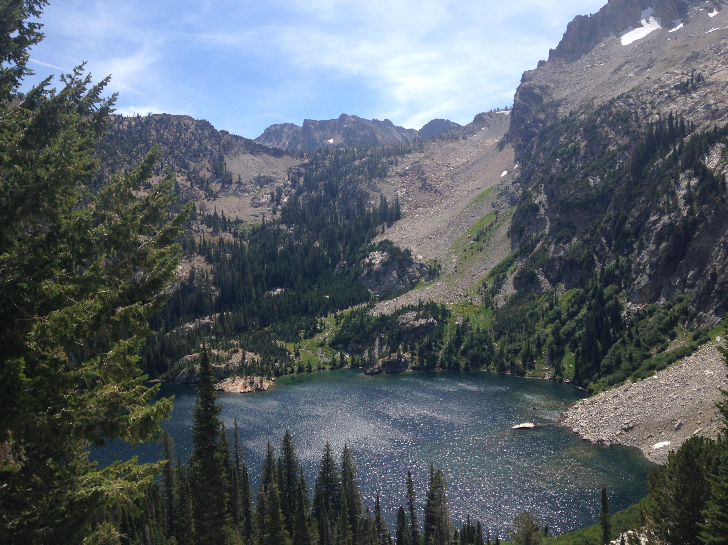
Questions

